Slide 1
Dice Pip Detection
James Young

Slide 2
Motivation

Slide 3
Overview of Process
Get and convert foreground and background to grayscale
Subtract BG from FG
Gaussian blur
Otsu threshold
Canny edge detection
Find contours
Iterate through contours
Use contours to obtain bounding boxes
Crop out and resize bounding boxes from original image
Secondary grayscale conversion, gaussian blur, and Otsu threshold
Bucket fill corners
Blob detection, count blobs

Slide 4
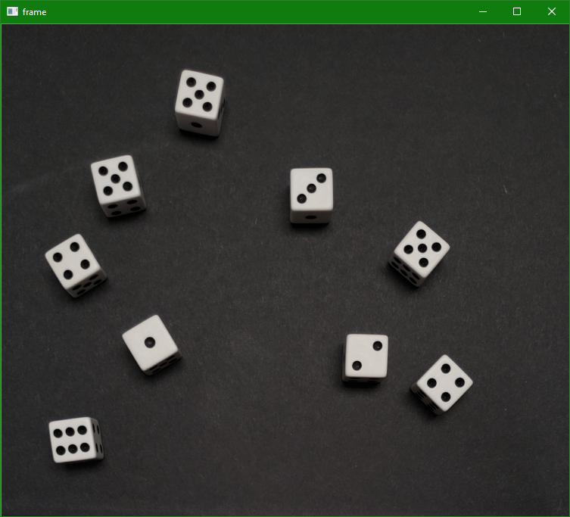
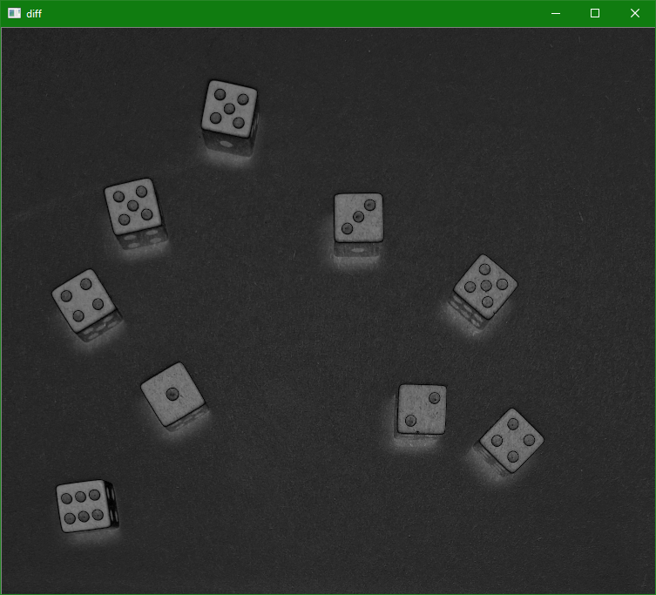
Foreground - Background

Slide 5
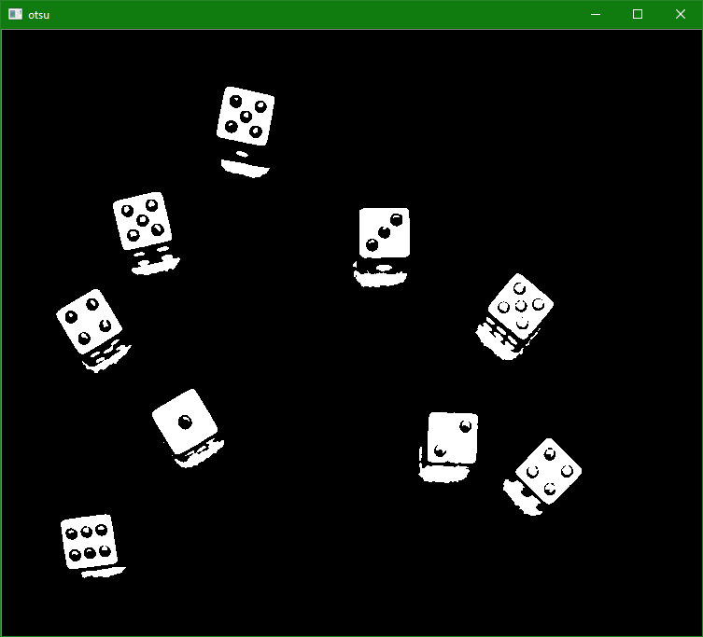
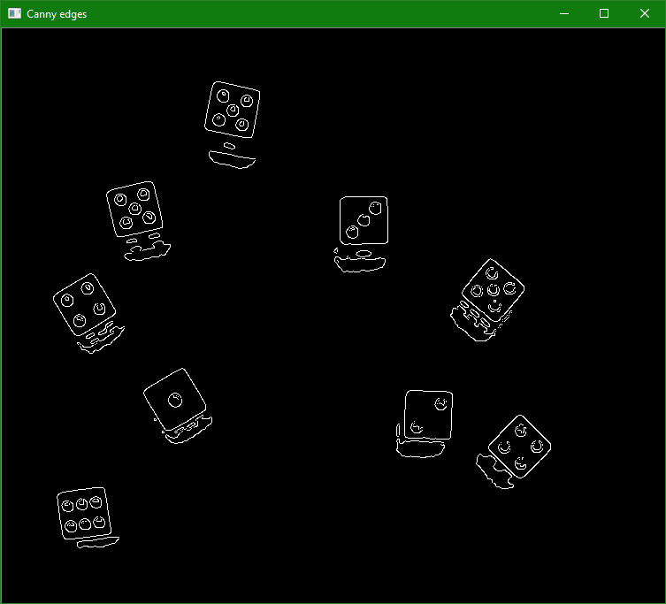
Otsu Threshold and Canny Edge Detection

Slide 7
Problems Faced

Slide 8
Applications

